Slide 1

BLOGGING SYSTEM
Submitted By
Nikesh Ghagarkar (0829CS181090)
Rahul Dogney (0829CS193D07)
Ravi Singh (0829CS181121)
Shoaib Malik (0829CS181141)
Submitted To
Ms. Sameeksha Khandelwal

Slide 2
CONTENTS
01
02
03
04
05
Abstract
Problem Domain
Solution Domain
Features
Picture & Diagram
06
Learning From the project

Slide 3
ABSTRACT
The term blogging and blog is a latest buzz word in the modern society as more people started reading and writing blogs online. The purpose of Blogging System is to fulfilling their requirements technical posts like some programming concepts , discussion error during project .It is a good medium for every body to write and publish their opinions online.
01

Slide 4
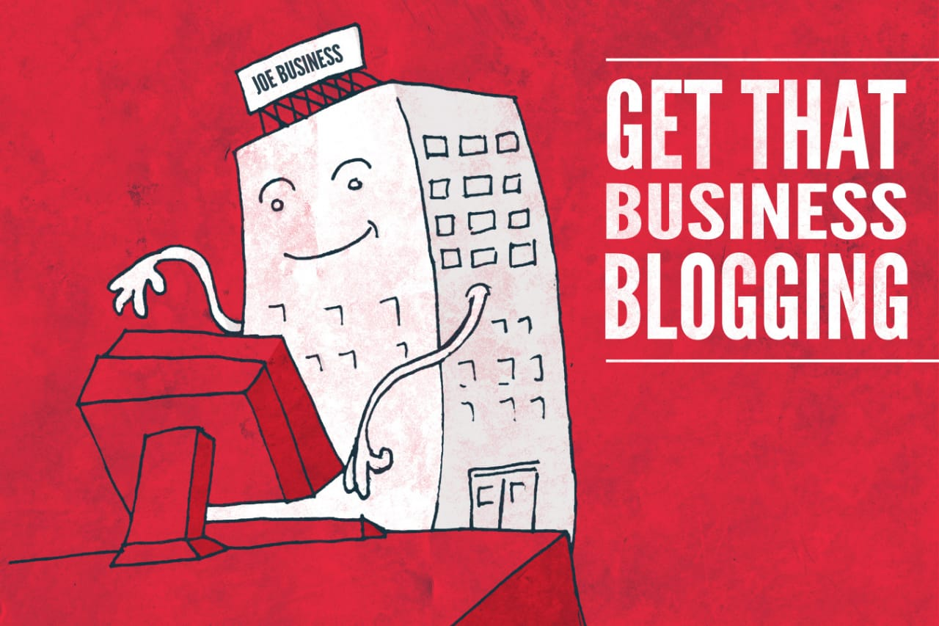
2
Challenge is to give a medium for people to express their opinions online very easily and allow reading that any time from anywhere.
Problem Domain
Challenge is to prepare a blogging platform for mobiles and a website to support and publish those blogs online. As number of people using the mobiles increasing, it will be much easier for people to read, write and post comments using mobiles.
Challenge is to develop, integrate and deploy different technological components to make an easy Blogger on mobiles.

Slide 5
3
Solution Domain
Blogger System allows users to create and publish blogs online and also allow reply to the existing blogs.
Delivered on schedule within the budget.
Blogging System Domain solution is a Windows , mobile client application which will allow users to read the blogs through the help browser.
Blogger System allows users to write and keeap the blog as a draft until it is fully ready for posting online.
Be easy to understand by the user and operator
Have a good user interface.

Slide 6
4
Features of The Blogging System
Useful Content
Attractive Headlines
Security and Spam Protection
Contact methods
1
2
3
4
Our blog try to post and maintain quality content .The headlines of blog post can help attract traffic on blog . Overcome the visitor want to spam our blog or hack it for their cybercriminal activities. Some people will want to post irrelevant comments or link-spam on your blog to link them back to their sites for higher ranking.
When people find interesting content on your blog, some want to connect with you, provide private feedback, or seek clarification.

Slide 7
5
System Domain
Software
Hardware
Technology :- Python , Django (Framework) .
IDE :- Visual Studio Code
Client-Side Technologies :–HTML,CSS,
Js.
Database Server :- SQL lite.
Operating System :- Windows 10.
Processor
Ram 1GB (or) higher
Hard Disk 80GB (or) higher

Slide 8
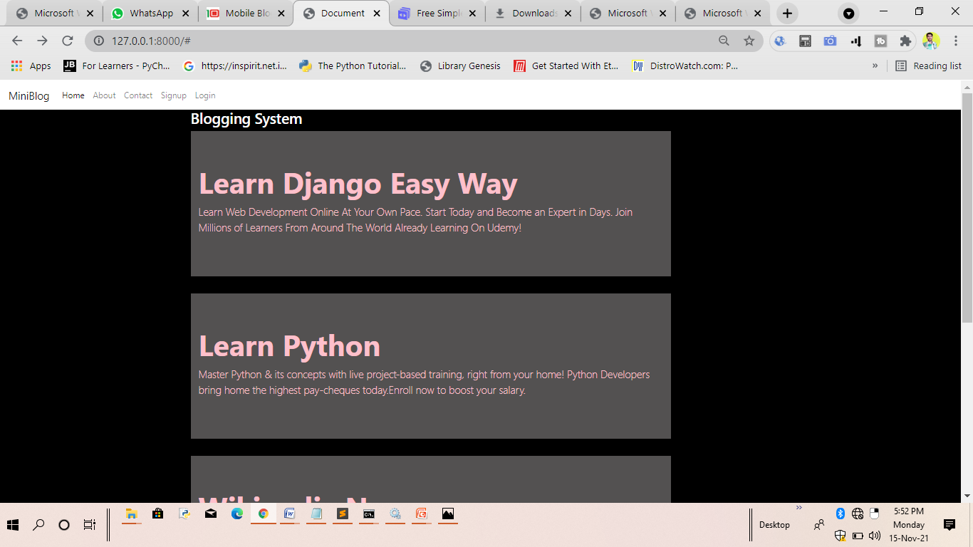
Home Page

Slide 9
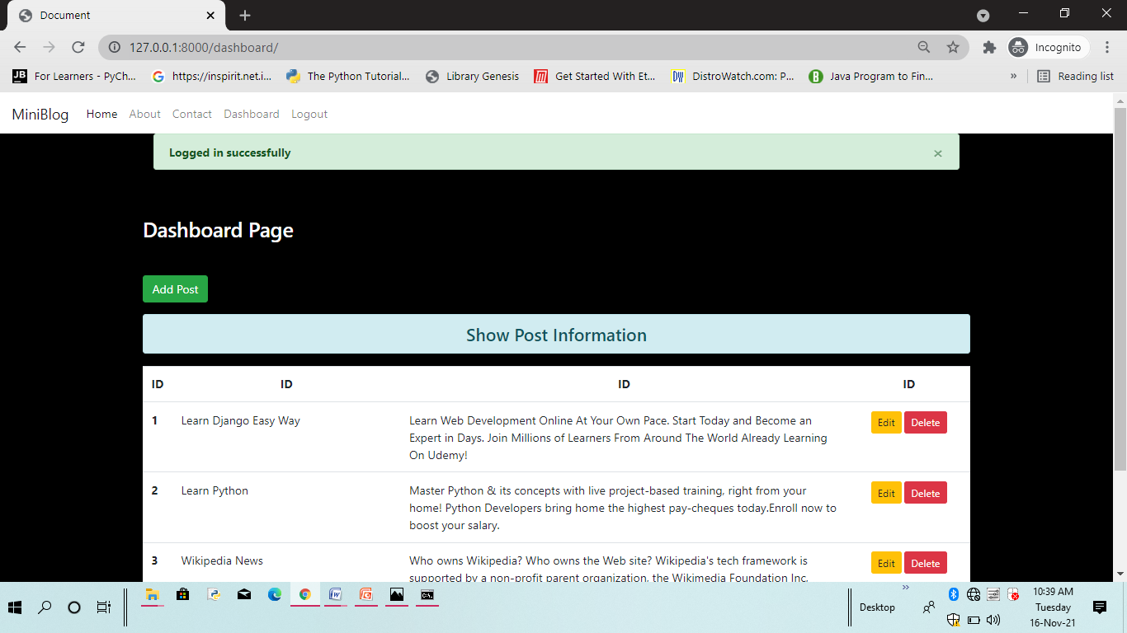
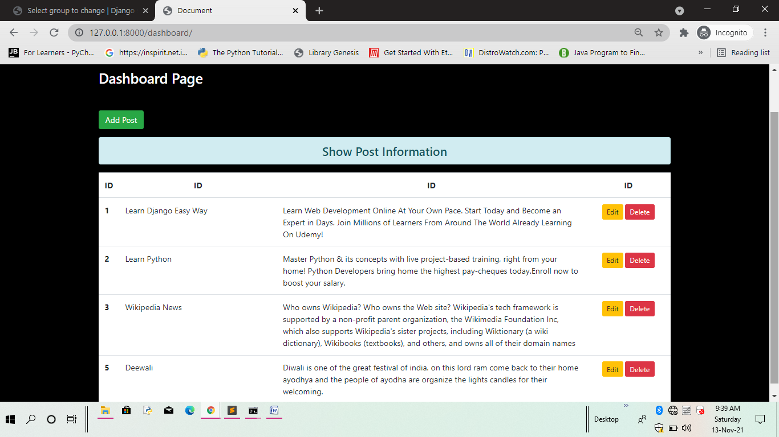
Dashboard Page

Slide 10
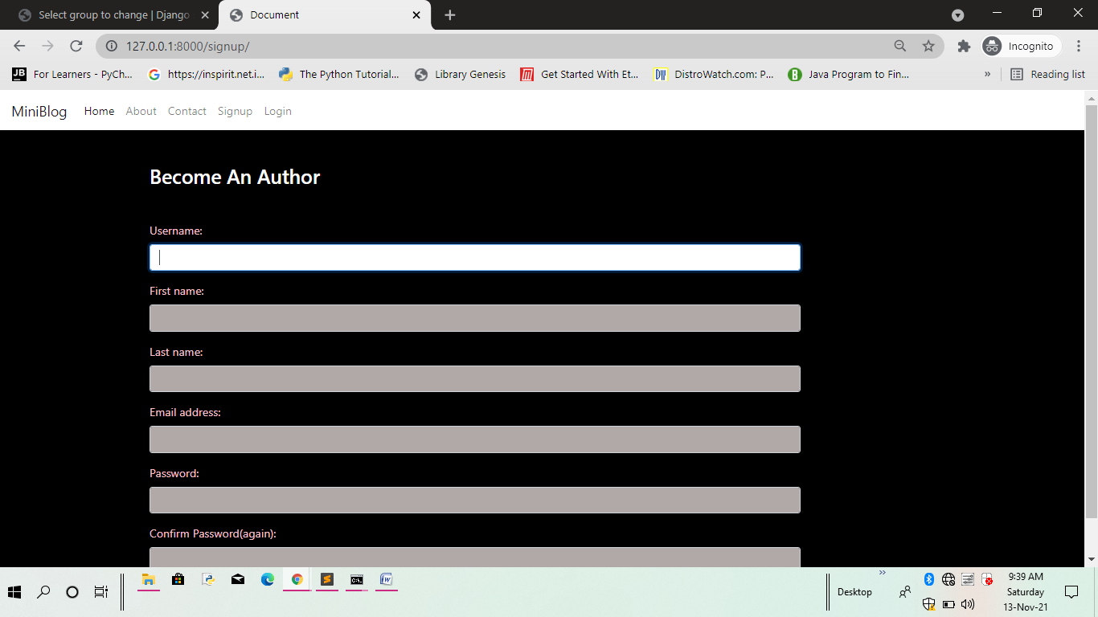
Signup Page

Slide 11
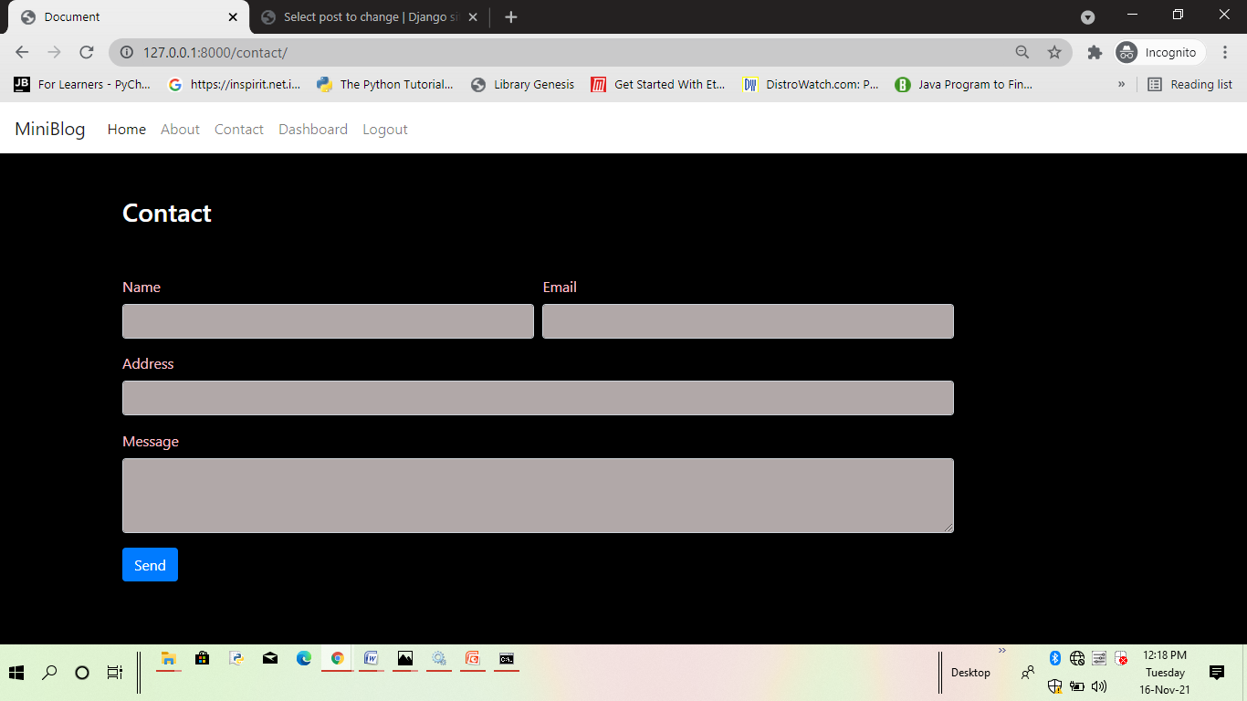
Contact Page

Slide 12
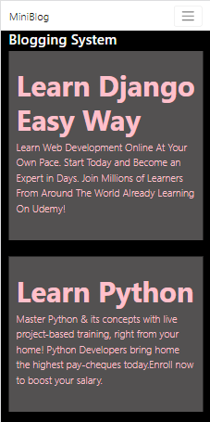
User Interactive
Our blog is responsive design is vital to keep and attract users who rely on mobile devices.

Slide 13
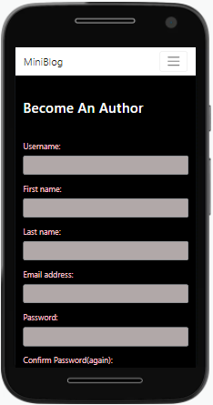
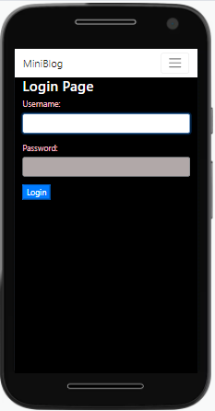
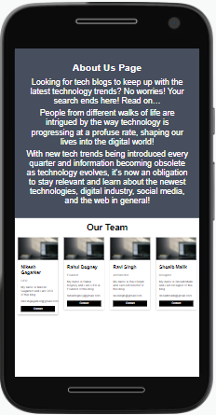
SignUp Form
Login Form
About Us page

Slide 14
Blogging System
6
Use Case Diagram

Slide 15
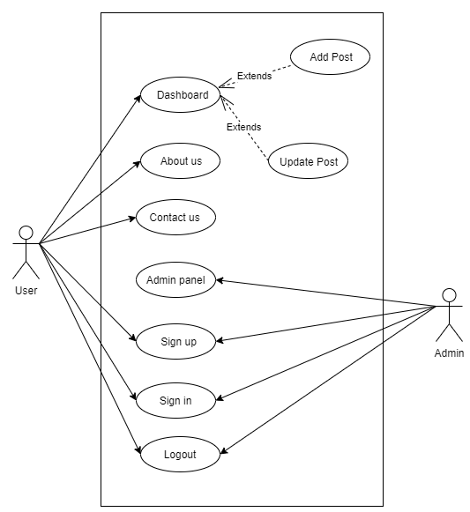
Use Case Diagram

Slide 16
Python Django Framework ,
Database management
Deployment of live project
on the server
Learning From The Project
Solve real world problem
using web application
Working with a team ,
as well as management

Slide 17
5
Future Scope
Adding tutorials online related to any topic.
Get any information form various blogs and novels
Add more categories and Information.

Slide 18
THANKS You !

